Slide 1

Shopper Spectrum: Customer Segmentation and Product Recommendations

Slide 2
PROJECT OVERVIEW
To understand customer purchasing behavior and group them based on RFM metrics. Additionally, recommend products using item-based collaborative filtering.

Slide 3
DATASET OVERVIEW
Source: online_retail.csv
COLUMNS : Invoice No, Stock Code, Description, Quantity, Invoice Date, Unit Price, Customer ID, Country

Slide 4
DATA CLEANING & PREPARATION
Removed duplicates and missing CustomerIDs.
Excluded cancelled invoices (InvoiceNo starting with “C”).
Kept only positive Quantity and UnitPrice.
Converted InvoiceDate to datetime format for time-based analysis.

Slide 5
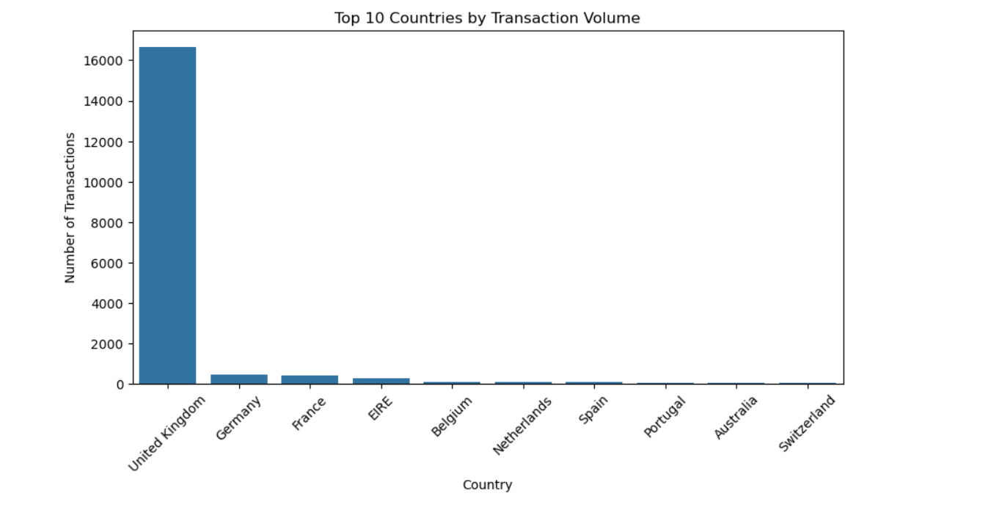
EXPLORATORY DATA ANALYSIS

Slide 6
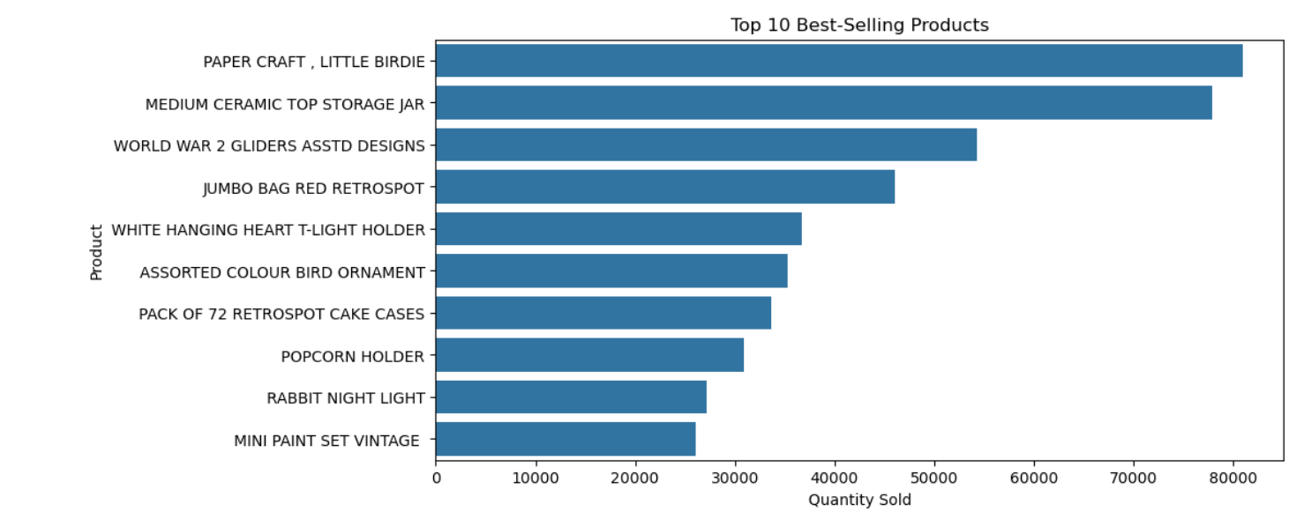
EXPLORATORY DATA ANALYSIS

Slide 7
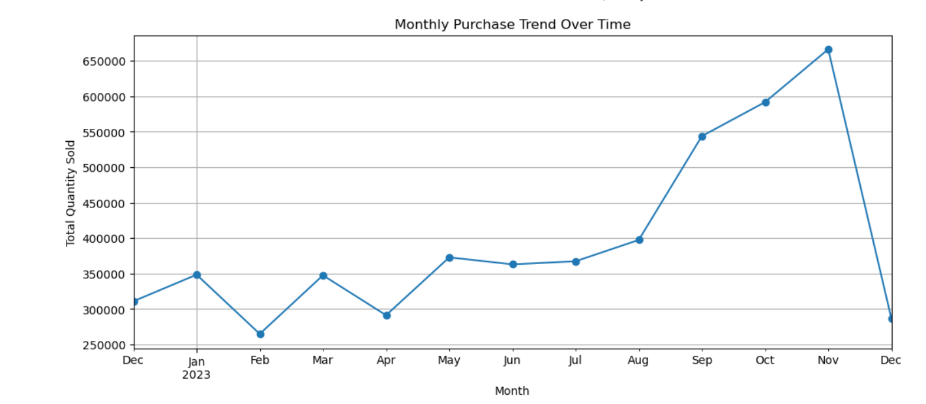
EXPLORATORY DATA ANALYSIS

Slide 8
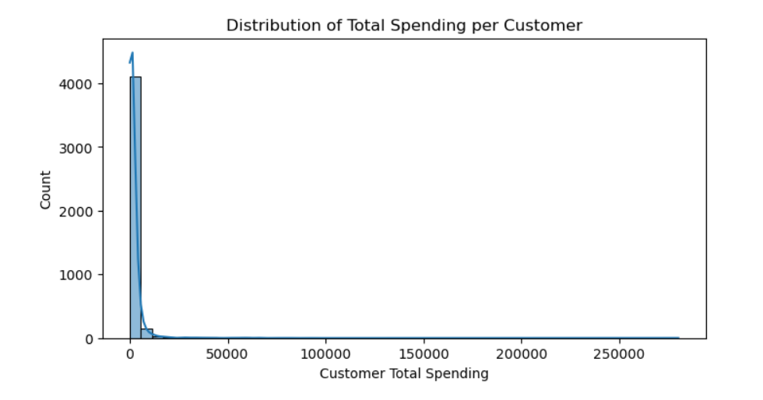
EXPLORATORY DATA ANALYSIS

Slide 9
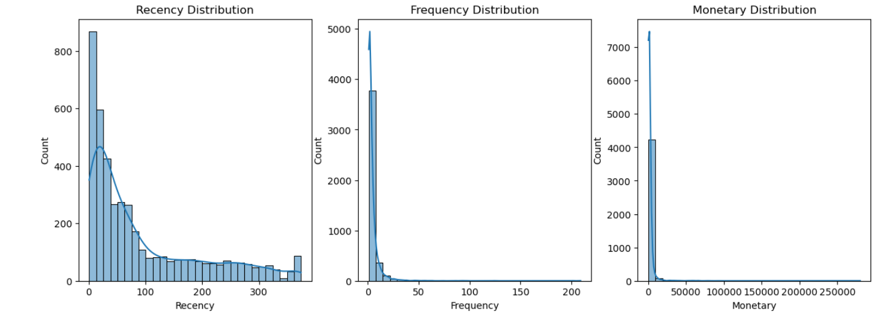
RFM DISTRIBUTION

Slide 10
RFM FEATURE ENGINEERING
Recency: Days since last purchase.
Frequency: Number of unique invoices.
Monetary: Total spend per customer.
RFM table exported for further modeling.

Slide 11
DATA TRANSFORMATION & SCALING
Applied log transformation to normalize skewed RFM features.
Standardized values using Standard Scaler.
Ensured balanced weight for clustering.
This preprocessing helps KMeans find meaningful clusters.

Slide 12
CLUSTERING (K MEAN)
Used Elbow Method to determine optimal K (4 clusters).
Clustered customers into:
  High-Value Customers – low Recency, high Frequency & Monetary.
  Regular Customers – consistent engagement.
  Occasional Buyers – irregular purchase pattern.
  At-Risk Customers – inactive for a long time.

Slide 13
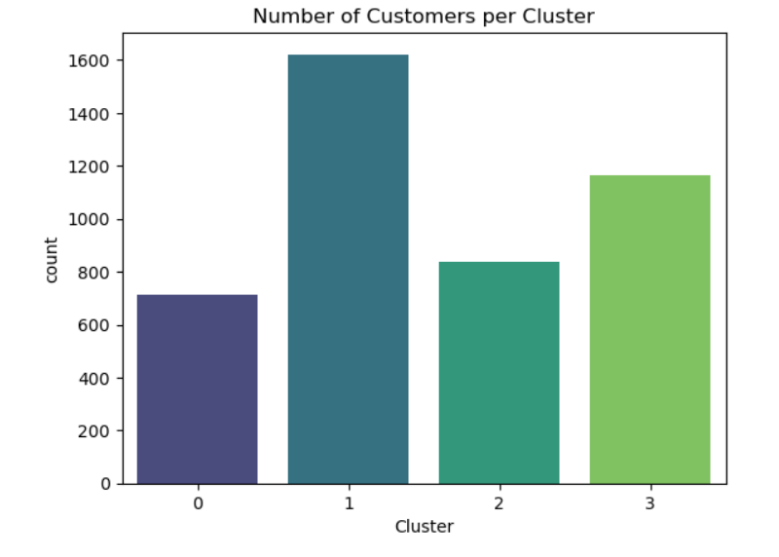
CLUSTER SUMMARY
For each cluster, calculates mean Recency, Frequency, Monetary — used to profile the clusters (who are high-value, who’s at risk).
Count shows cluster sizes.
Bar chart showing how many customers fall into each cluster.

Slide 14
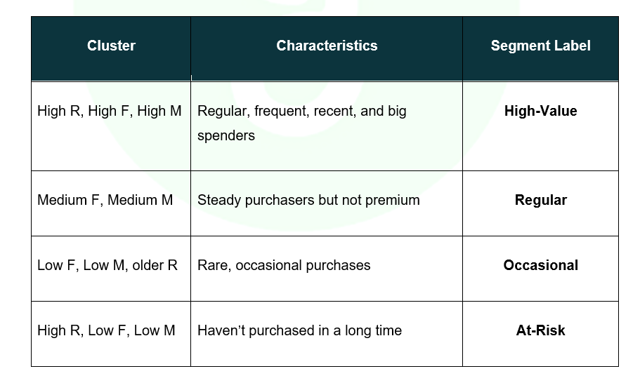
SEGMENT LABELING
Logical ordering of clusters.
Segment labels applied:
  High-Value ---loyal VIP customers
  Regular ---steady buyers
  Occasional --- moderate potential
  At-Risk --- reactivation targets.
Each segment used for targeted marketing actions.

Slide 15
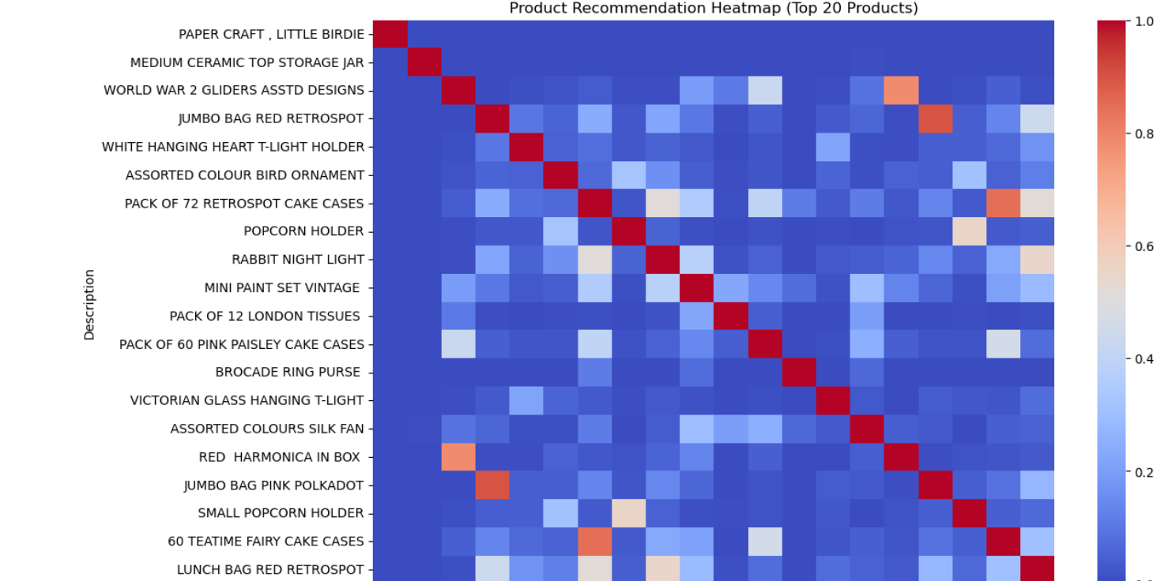
COLLABORATIVE FILTERING
Built Item–Item Cosine Similarity Matrix from purchase patterns.
Identified top 20 frequently bought products.
Generated Product Recommendation Heatmap to visualize correlations.

Slide 16
STREAMLIT APP DASHBOARD
User-friendly dashboard for:
Viewing RFM clusters and segment summaries.
Entering product name - getting recommended products.

Slide 17
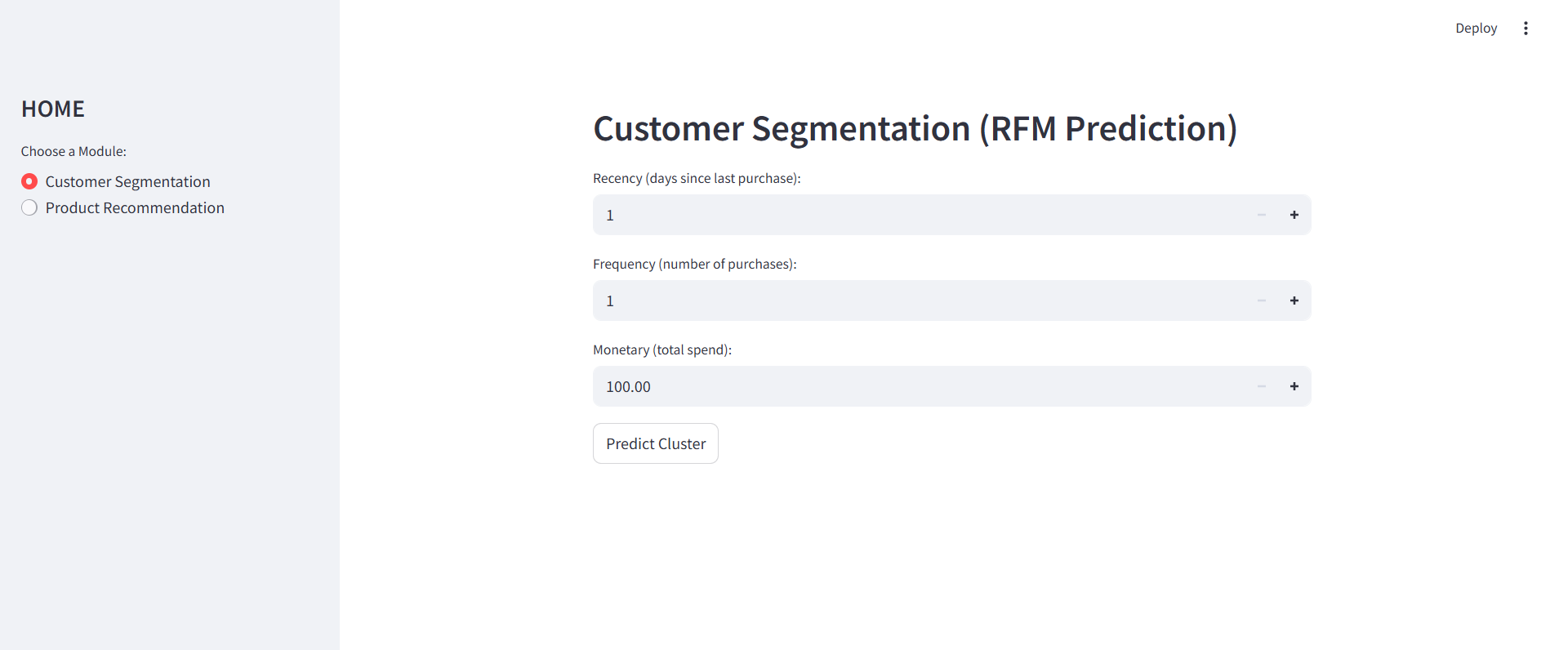
CUSTOMER SEGMENTATION-RFM prediction

Slide 18
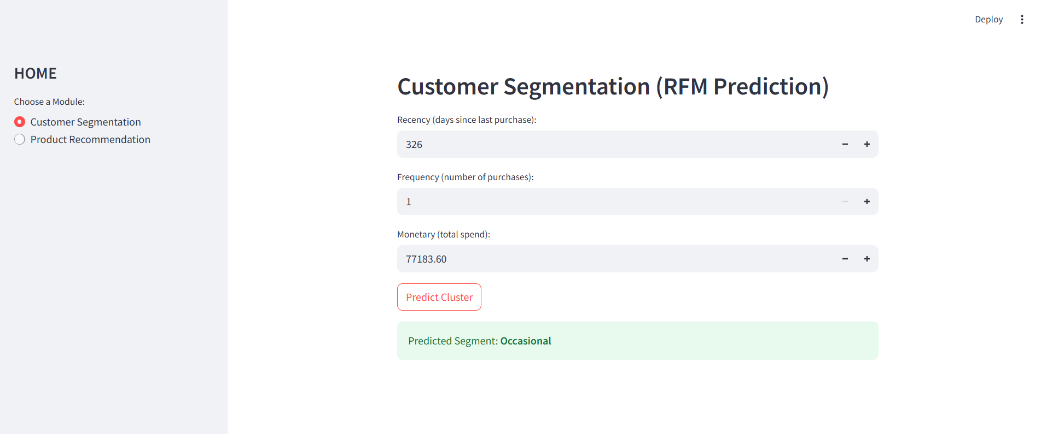
CUSTOMER SEGMENTATION-RFM prediction

Slide 19
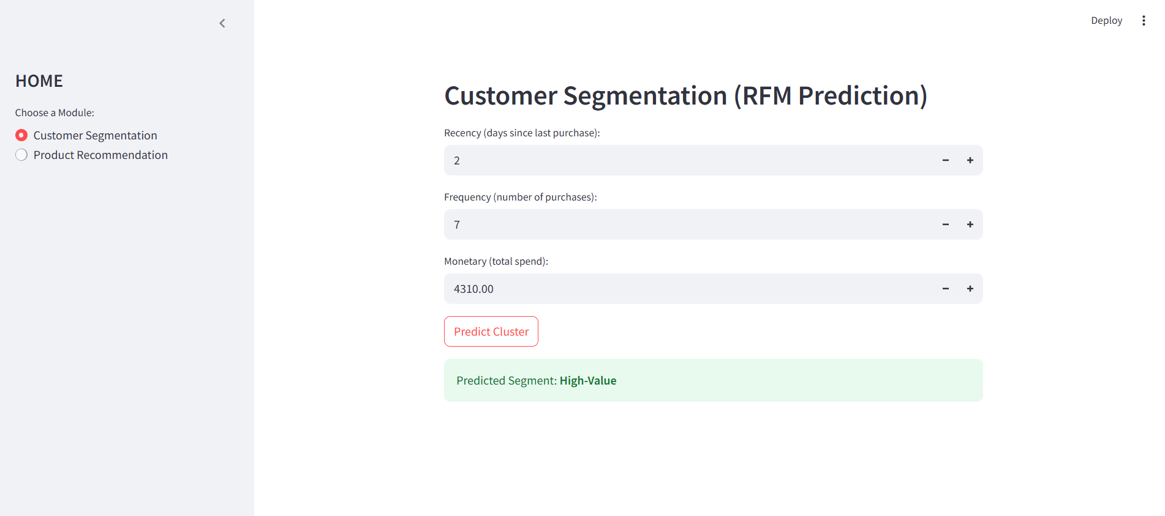
CUSTOMER SEGMENTATION-RFM prediction

Slide 20

CUSTOMER SEGMENTATION-RFM prediction

Slide 21
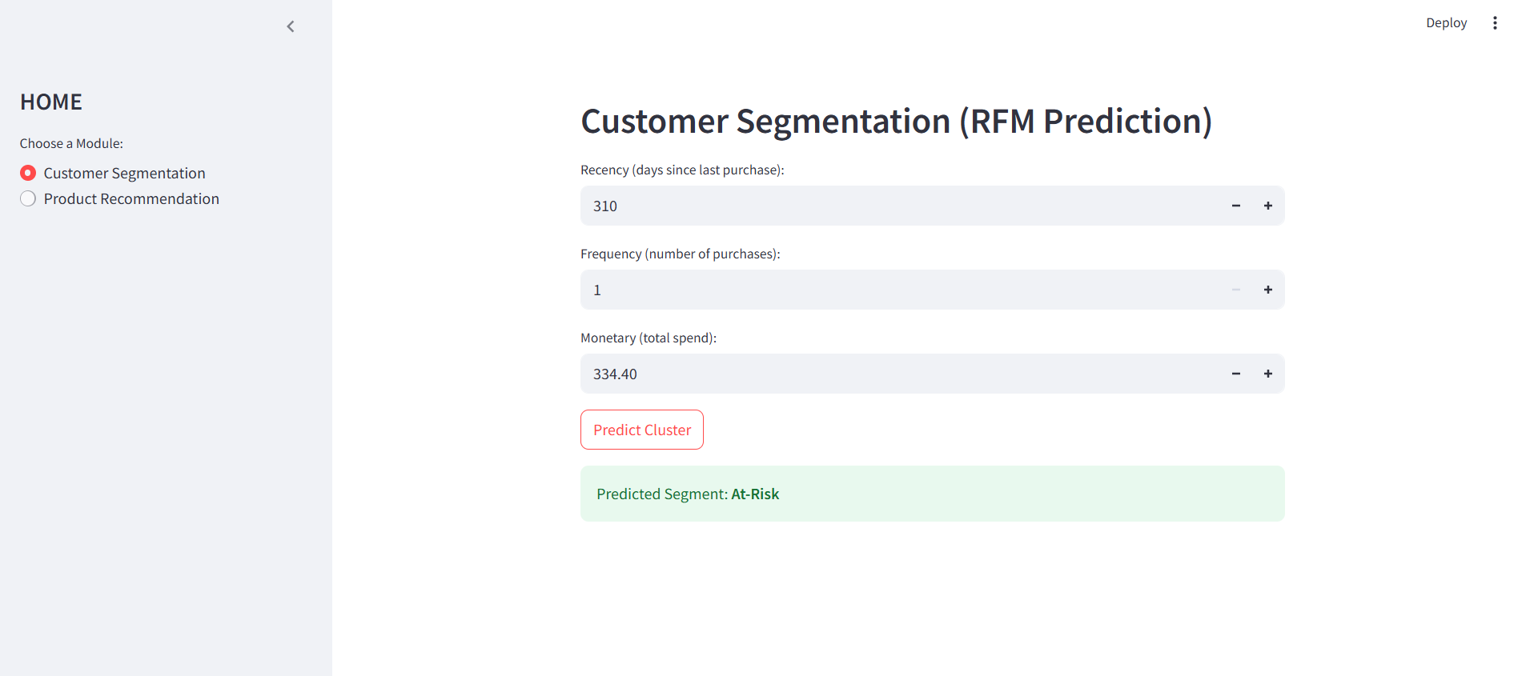
CUSTOMER SEGMENTATION-RFM prediction

Slide 22
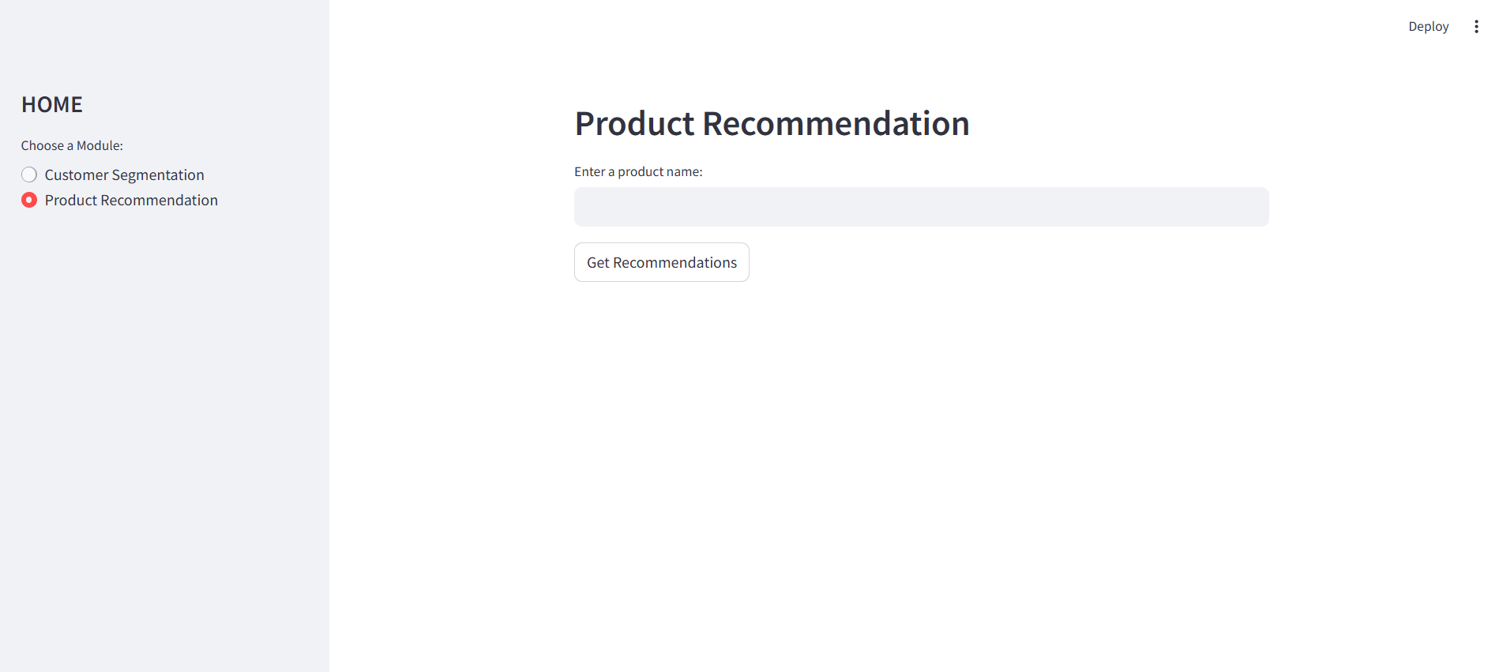
PRODUCT SEGMENTATION

Slide 23
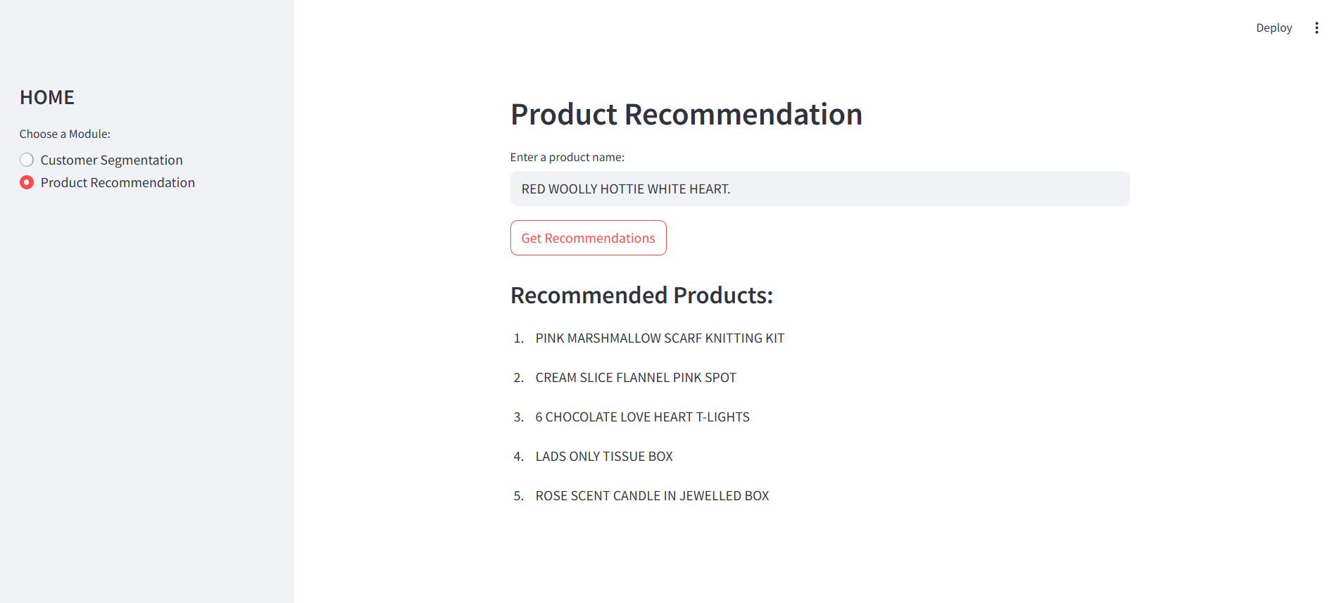
PRODUCT SEGMENTATION

Slide 24
FUTURE ENHANCEMENTS
Test other clustering algorithms (DBSCAN, Hierarchical) for better pattern detection.
Deploy as a multi-user cloud app- Fully automated and cloud-based system.

